Slide 2
THE SPLASH MACHINE
LOGISTICS
Source & order all products
Food & beverage
Floor plans and event flow
Secure room blocks (attendees, staff, etc.)
Printing & shipping
Secure AV for all sessions
Oversee event and manage budgets
PD & CONTENT
Source, negotiate and secure all speakers and session topics
Manage PD trainers and facilitators
Secure all training materials & assets
Team set up and tear down of training sessions for Pre-Conference
Oversee event and manage budgets
MARKETING
Splash marketing strategy
Create marketing assets (website pages, email blasts, brochures, flyers, evites, etc.)
Social media & digital ads
Videos (promotional & highlights video)
Onsite program & schedules
Splash APP (features, content, chat, etc.)
Produce 5 General Sessions (PPTs, scripts, etc.)
Surveys & Analytics
Special services
Create and source all onsite decor (visuals, photo booth, special gifts, prizes)
Signage throughout the event
VIP Luncheon décor
Awards Dinner décor
Advisory & Customer events.
Hotel logistics
Exhibit Hall (vendors and activities)
(Bill)
(Ali)
(Cassie)
(Mindy)
MARKETING
Special services
SPEAKERS
LOGISTICS
PD & CONTENT
registration
OPERATIONS
SALES TEAM
BOOTH
REGISTRATION
Recruit and manage all staffing and volunteers for registration events (incorporate HR protocol)
Oversee all registration events
Managing staff and volunteers onsite
Information Desk
booth
Design, source and manage Frog Street Booth in Exhibit Hall
Create booth schedule and manage staff
Plan and announce booth promotions
Interact with customers and sell product
Source inventory and manage Fanny’s Attic
OPERATIONS
Manage all product shipment and event space placement
Manage all door prizes
Set up all Frog Street AV
Onsite volunteer management
Sales ENABLEMENT
Create plan for sales meeting space
Manage Account Executives’ Schedules during Conference
Facilitate customers, product presentations and network in Frog Street booth
SPEAKERS
Interface with keynotes and speakers to manage and finalize session content and all contracts
Create and manage “Author’s Corner” book signing event
(Lisa)
(Shannon)
(Tim)
(Pam)
(Mark)
Notes:
Welcome to the Splash Machine! These are all the interlocking “gears” of the Splash team – all connected and moving in one direction for the success of Splash!

Slide 3
SALES TEAM
Help to drive attendance
Frog Street Ambassadors
Event Facilitators
Meet & Greet and networking
Capture and share moments
Social posting & tagging
Engaging & interacting
Leverage hashtags
Prospect follow-up
Let’s close some deals!

Slide 4
Notes:
This year, we are offering over 75 educational sessions at Splash, including curriculum trainings in all our categories, 2 different Make & Takes, keynotes and sessions

Slide 5
1837
QUICK FACTS SPLASH REVENUE
Current to 2022
Registration UP 15.0%
M&T Training UP 42.3%
Total Revenue UP 6.9%
Goal to 2022
Registration UP 37.8%
M&T Training UP 93.5%
Total Revenue UP 42.4% $609K

Slide 6
QUICK FACTS SPLASH GROSS PROFIT
2022 Actual $644k
2023 Current $900k
2023 Goal $1176k … and

Slide 7
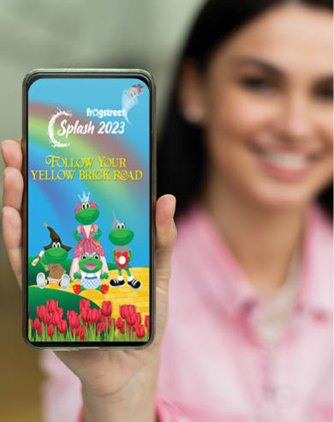
Splash 2023 APP

Slide 8
A FEW SPECIAL TOUCHES THIS YEAR:
Bringing back several popular speakers!
One flat fee for Make & Take and Curriculum Training!
A much bigger space for Exhibitor and new vendors!
Lunch for all attendees on Thursday and Friday - YAY!
Reserved seating and ticket for an adult beverage!
A special collectible surprise that will capture your heart! ❤️!
Notes:
Here are a few of the special touches we have planned this year to ensure Splash is a truly delightful experience!
Our customers asked, we listened! We’re bringing back several popular speakers that our customers love (and asked for!)
Combining Make & Take and Curriculum Training for one flat fee
A much bigger space for Exhibitors and additional vendors added to the list!
Lunch to all attendees on Thursday and Friday, YAY!
Reserved seating and a ticket for an adult beverage at the Awards Dinner to ensure the royal treatment!
A special collectable surprise that will capture all of our educators’ hearts!

Slide 9
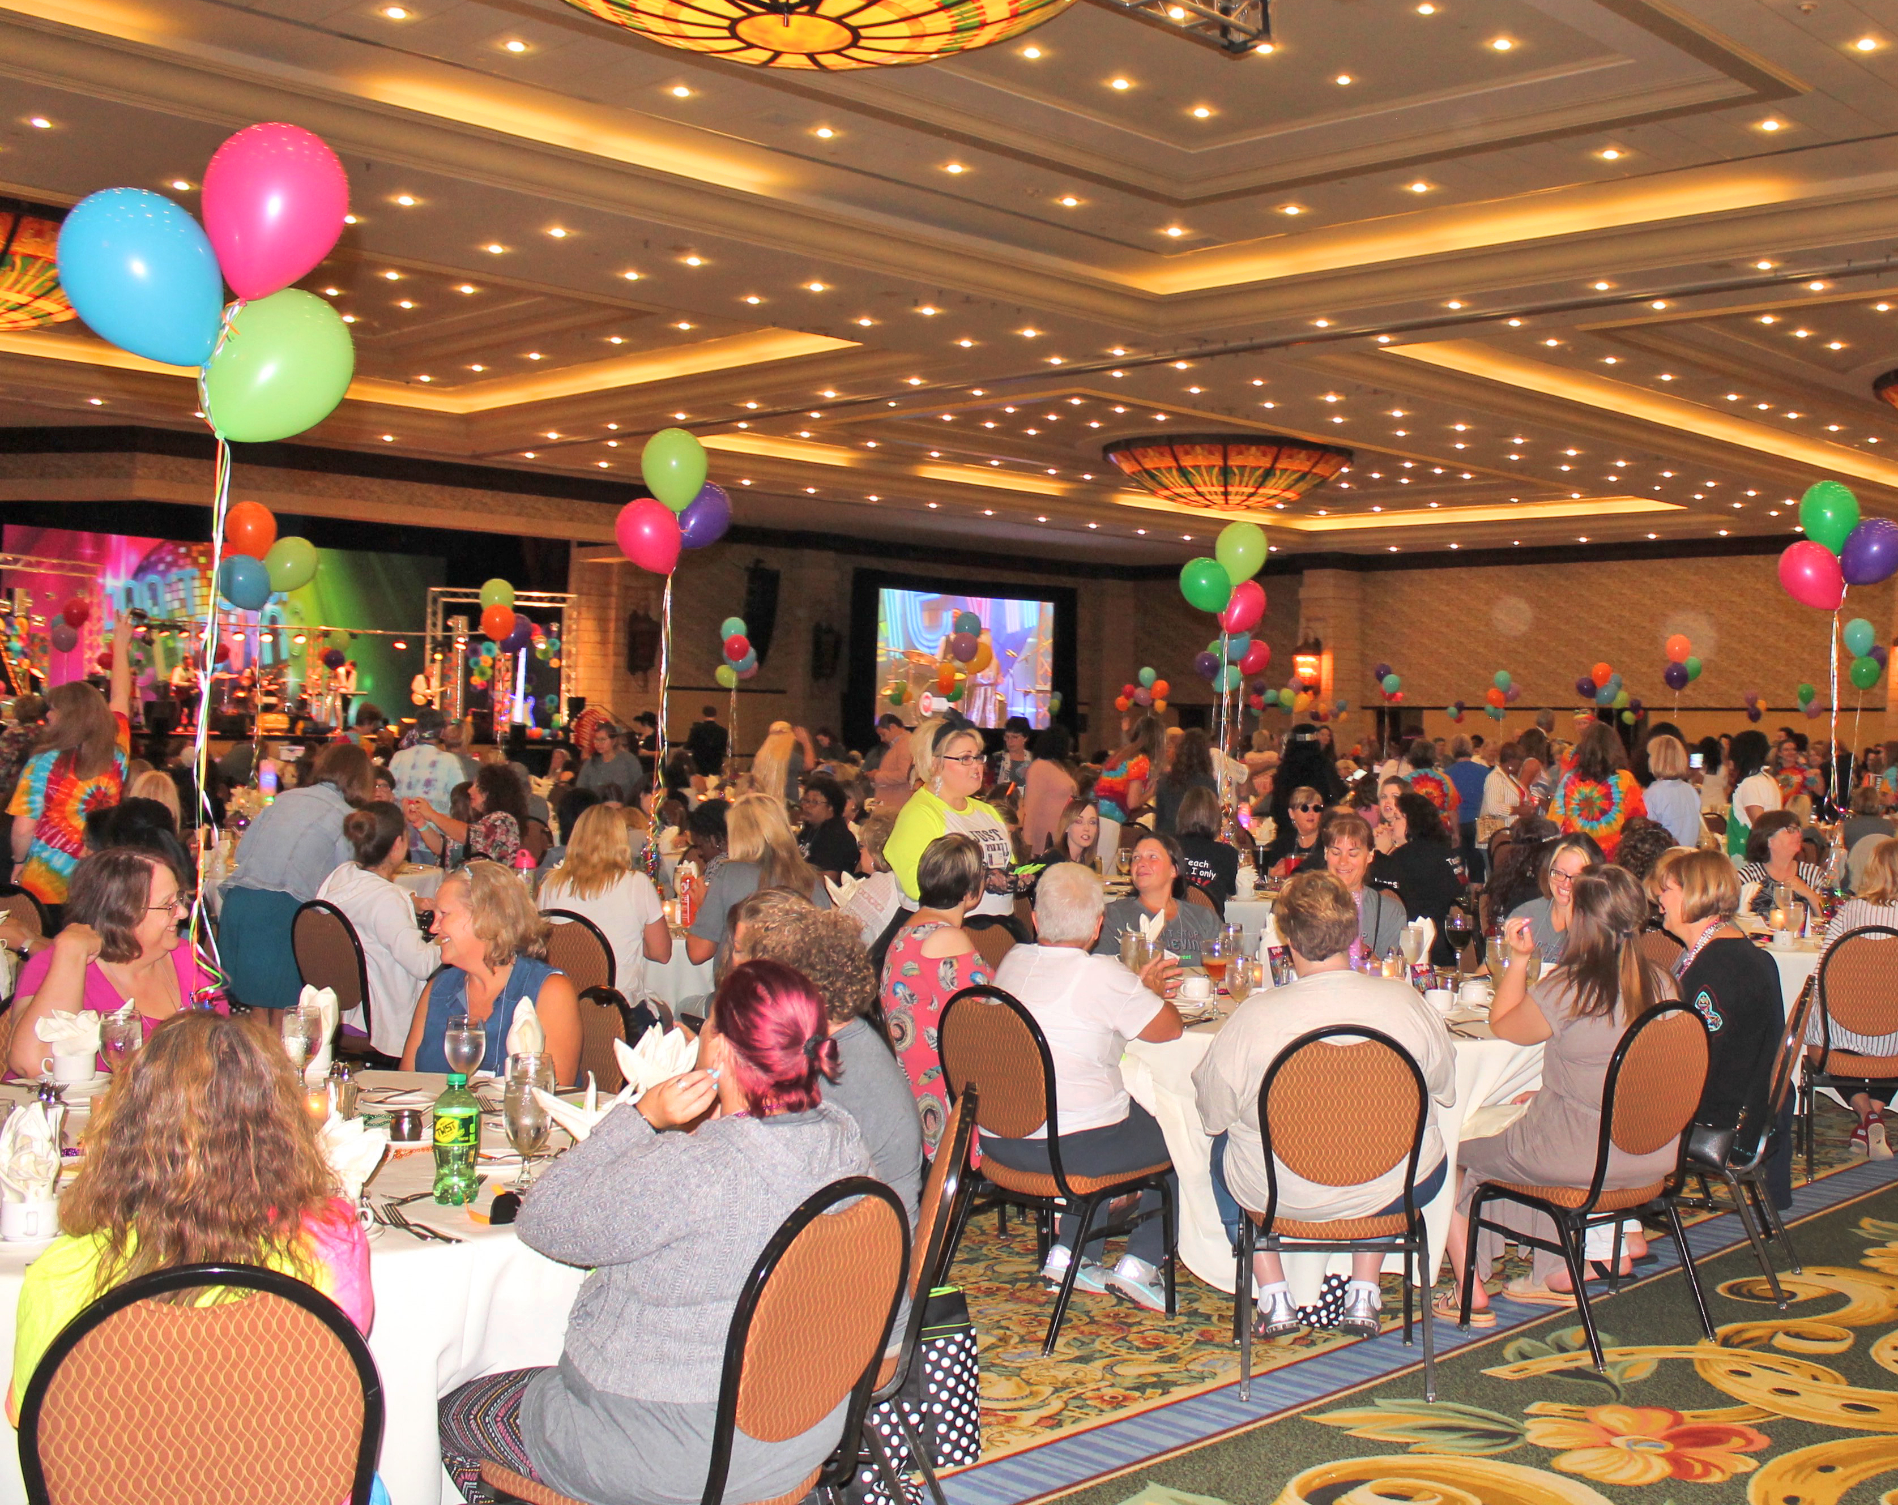
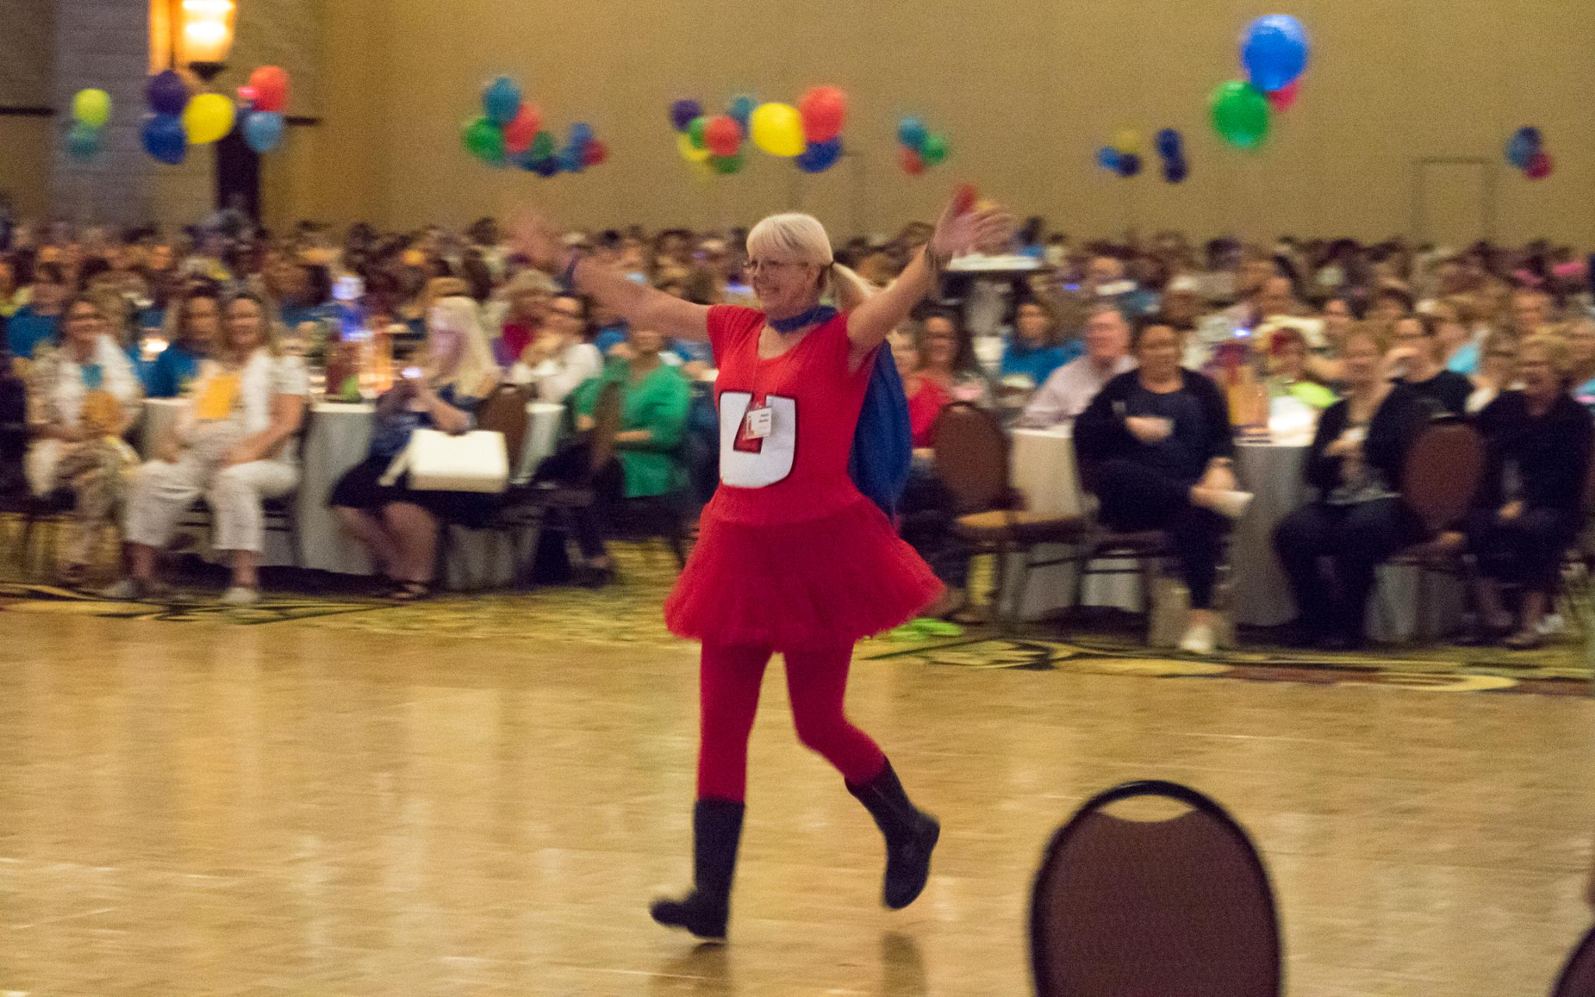
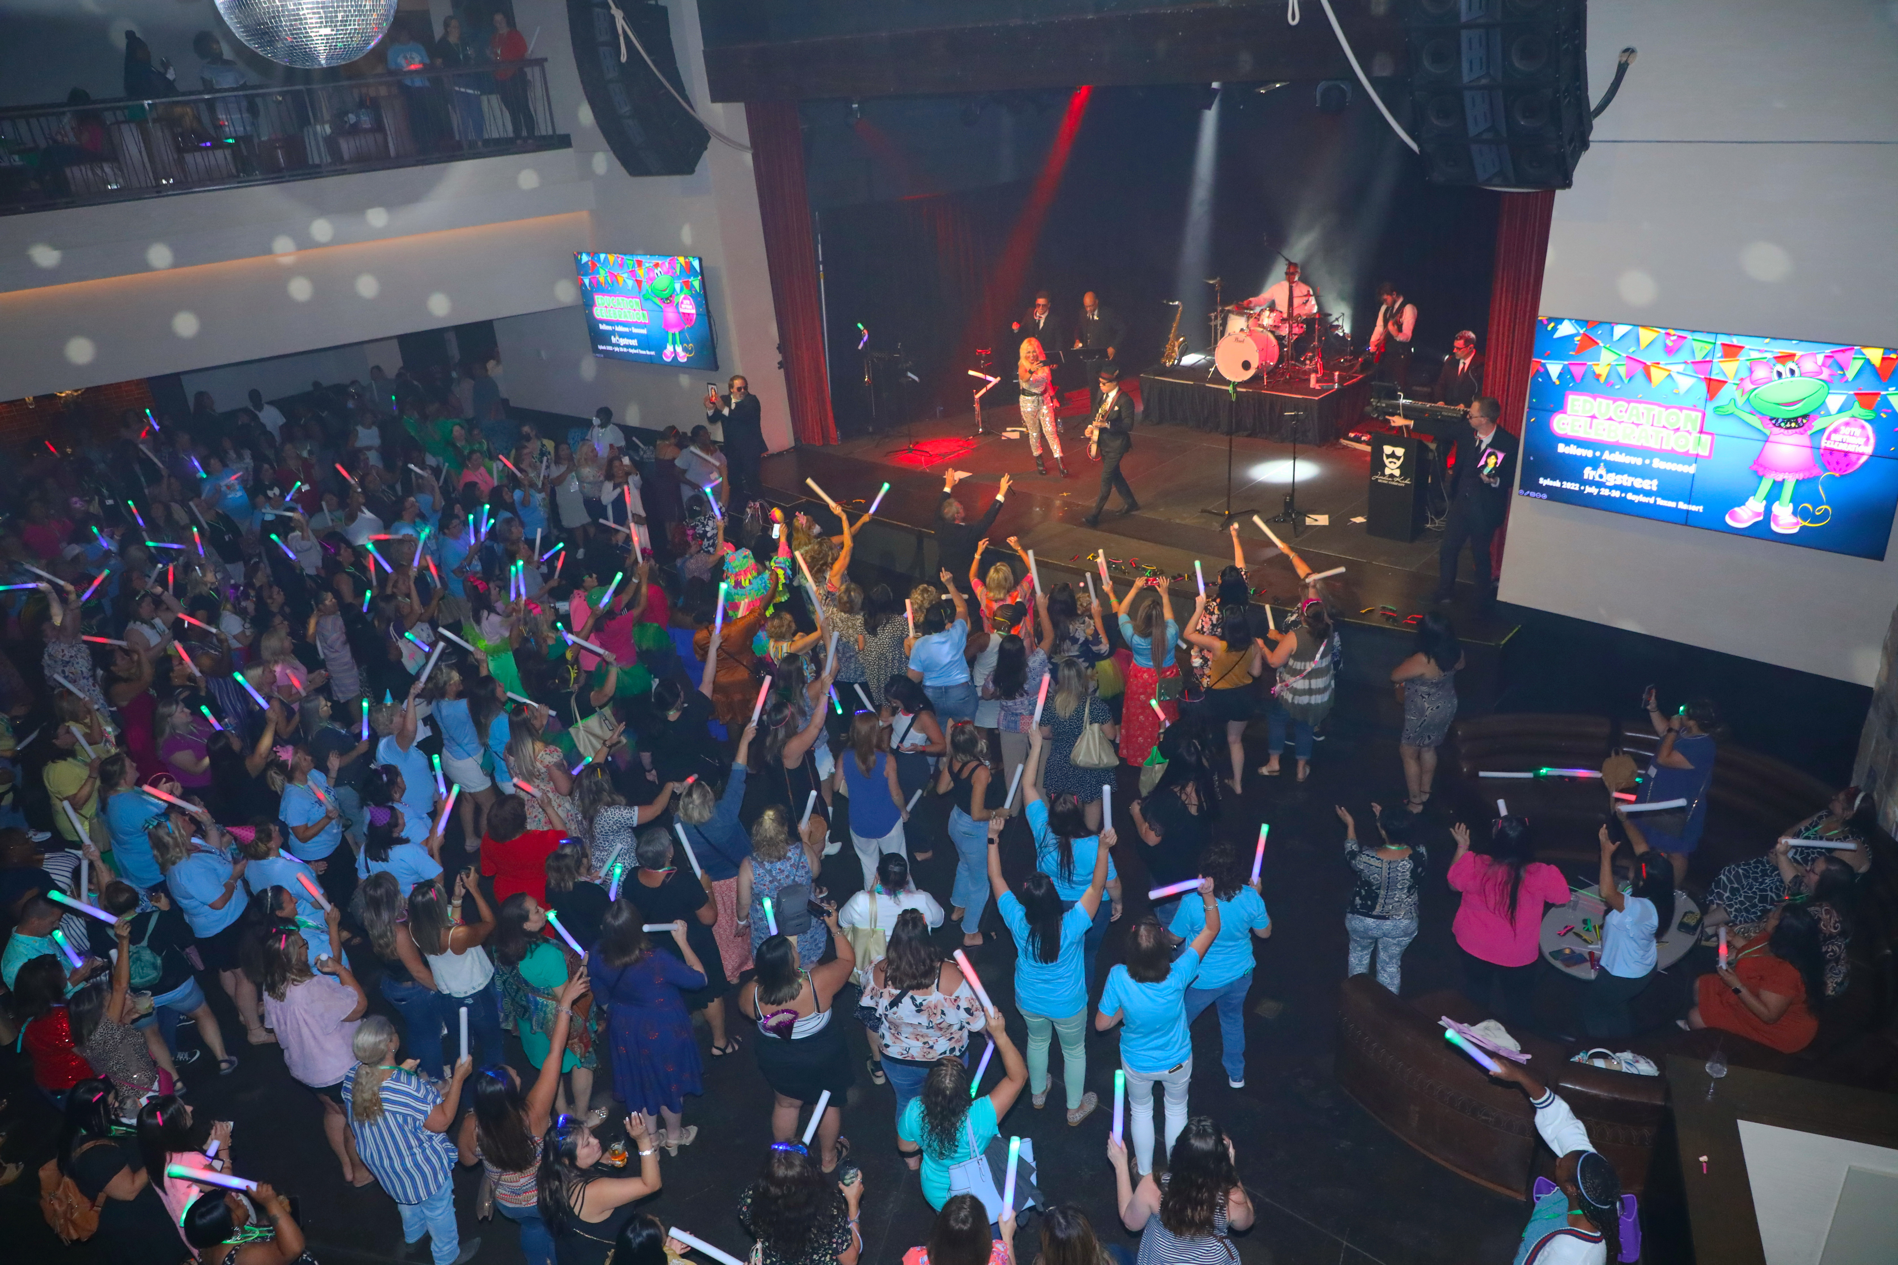
AWARDS DINNER & AFTER PARTY
Notes:
And of course an Awards Dinner and After Party that will be “Over the Rainbow!”

Slide 10
DRUM ROLL……..
Notes:
Yes, we have a secret! In case you haven’t heard, we are unveiling a special collectible puppet at the Friday morning General Session. Her name is….. “Wonderful Lily”! Get it? The Wonderful Wizard of Oz! All attendees will receive a ticket in their registration packet to pick up their very own collectible puppet in the Exhibit Hall. These are one of a kind and a limited print edition. Please keep this on the downlow until the big unveiling on Friday morning!

Slide 11
Splash 2023 Hashtag: #TheresNoPlaceLikeHome
Notes:
This is our hashtag for Splash this year! Please use this and tag Frog Street in all your social posts – and help us spread the word on this fantastic experience!

Slide 12
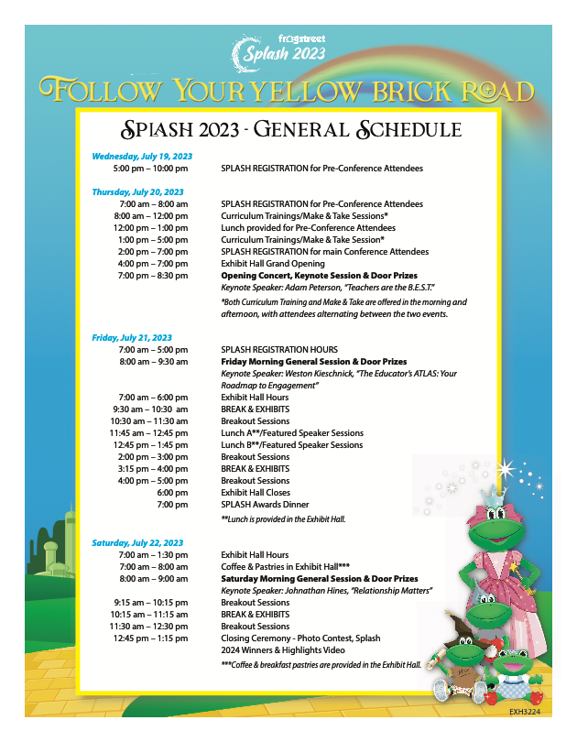
Splash 2023 Marketing Assets
Thank you for helping us spread the word!
Notes:
Brochures, Schedules, Promo slides etc. are available on the website, APP and in the Marketing & Sales Asset Folder on Dropbox!

Slide 13
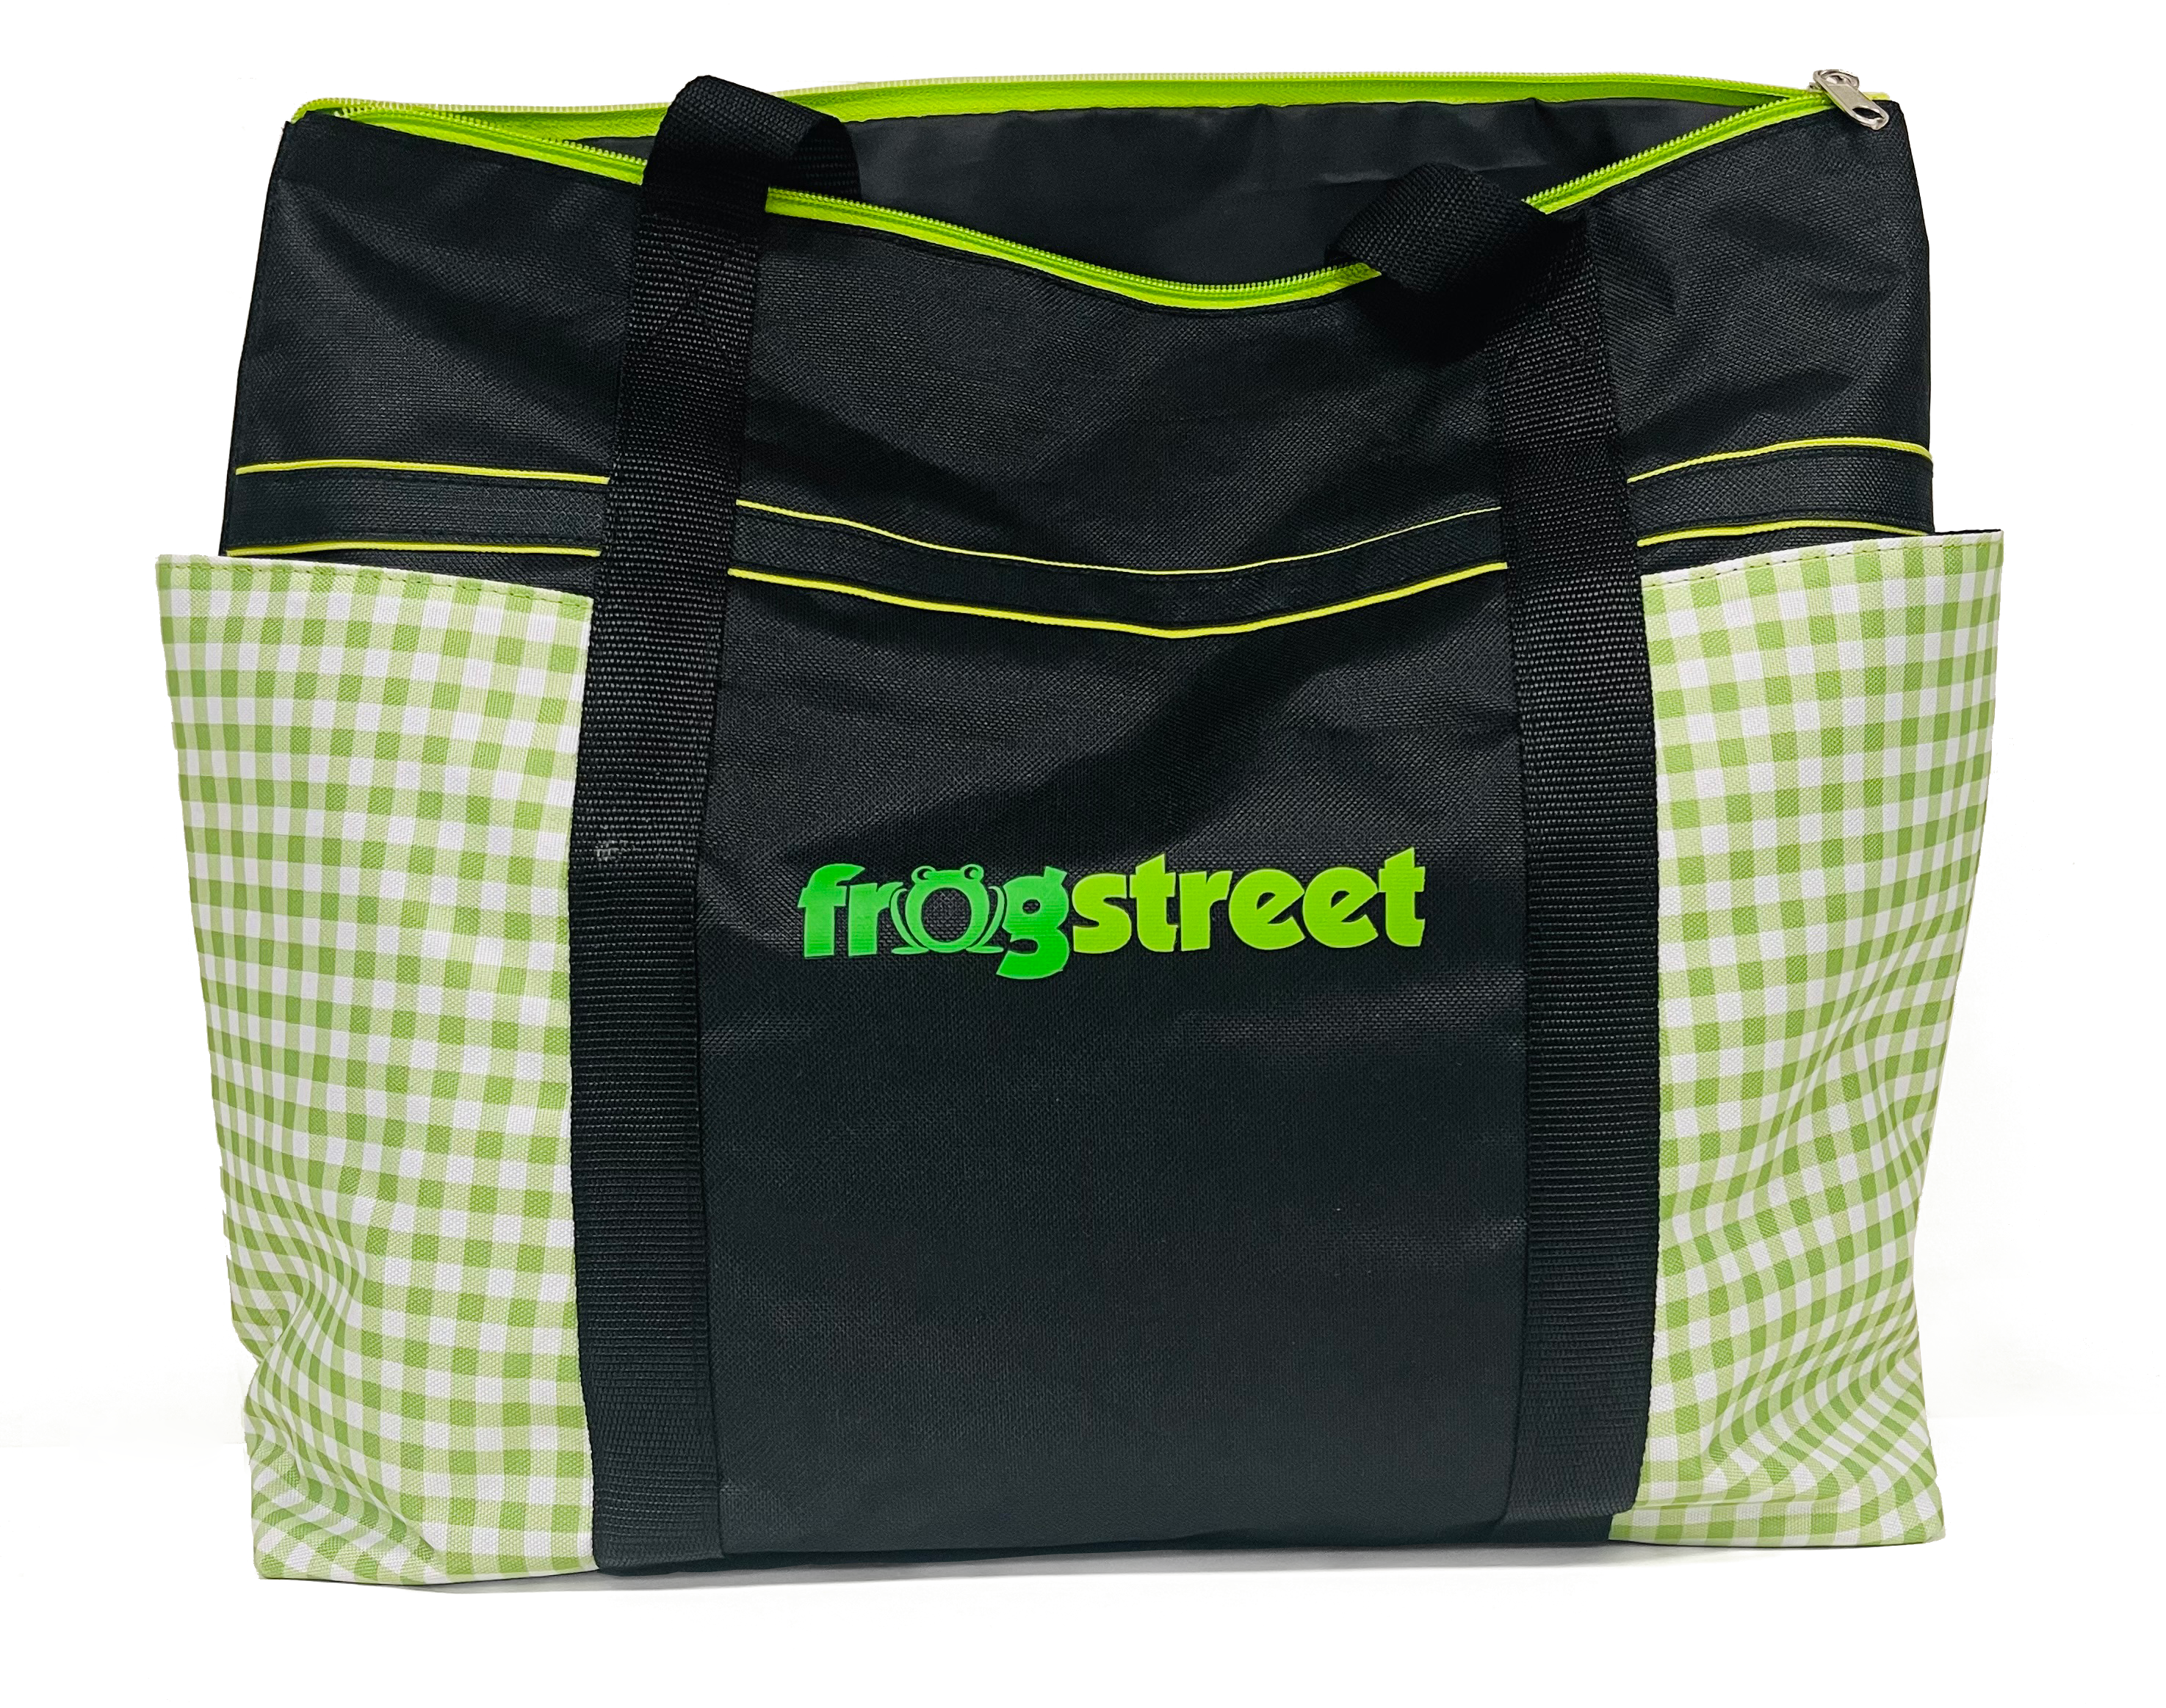
SPLASH SWAG THIS YEAR:
+
+
+
Notes:
These are all the wonderful items that everyone will receive at Splash this year (notice the visual nod to Dorothy’s infamous dress on the Tote Bag)!

Slide 14
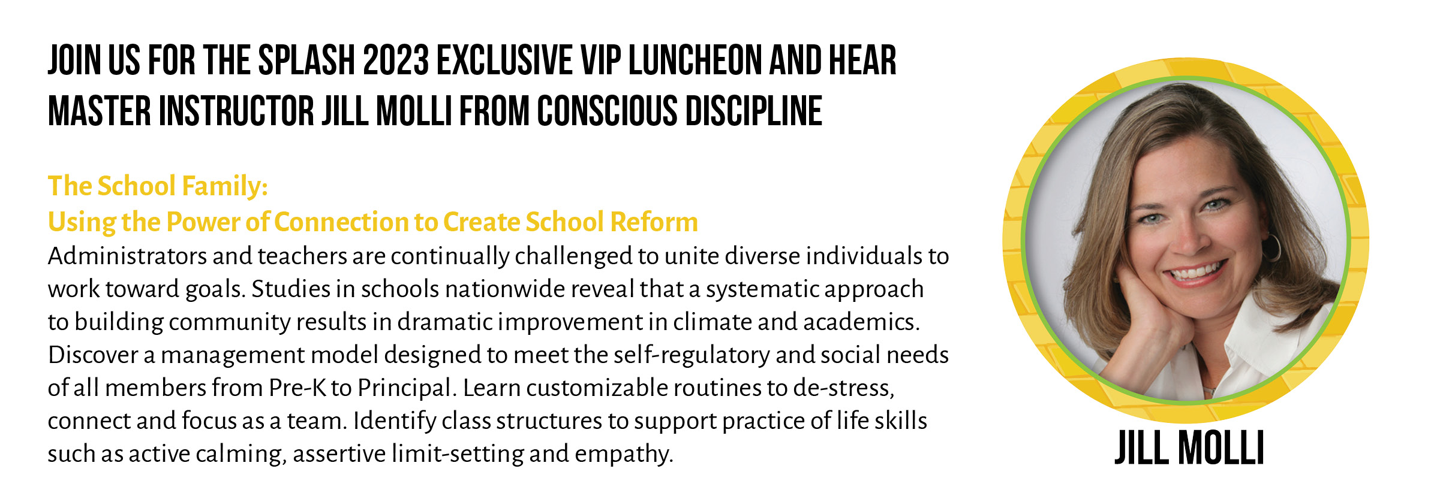
Completely Booked!
SPLASH 2023
VIP LUNCHEON

Slide 15
A FEW NOTES:
Because we are 100% laser focused on the customer, we have moved the Frog Street staff to the Marriott Courtyard down the street to open up additional rooms.
Parking at the Gaylord will be reimbursed for staff. Account Executives, please use your credit card. Look for more details and instructions on the APP.
The staff kick-off dinner begins at 6:30 p.m. in the Exhibit Hall on Wednesday evening. Some staff will not be able to attend as they will be helping out with registration (we will bring dinner to you!)
An email will be landing in your inbox the week before Splash with all the details of what to wear, when to check in, etc. – info will also be posted on the APP.
Be sure and download the APP, all notifications and updates will come through the private “Frog Street Family” feature. Let’s chat it up and keep each other informed.

Slide 16
Questions or ideas you’d
like to share about Splash?
Fill out this form here:

